Slide 1

WEB TECHNOLOGIES
Introduction to WWW,
Web Protocols and URLs
Dr.Sarasvathi V , Professor
Department of Computer Science and Engineering
Credit: Prof.Vinay Joshi

Slide 2

Introduction to WWW, Web Protocols and URLs
Common Terms
Internet vs. Web
Web Browsers
URL
Web Server
DNS
HTTP Protocol
HTTPS

Slide 3

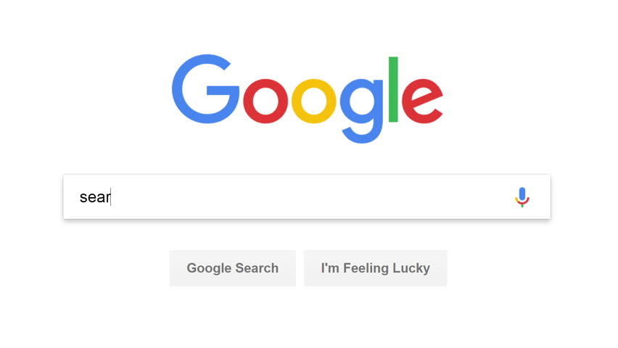
Introduction to WWW, Web Protocols and URLs
Internet vs. WWW

Slide 4
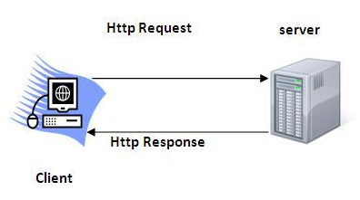
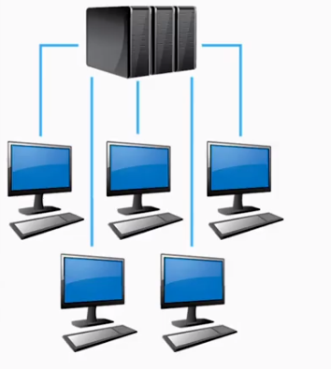
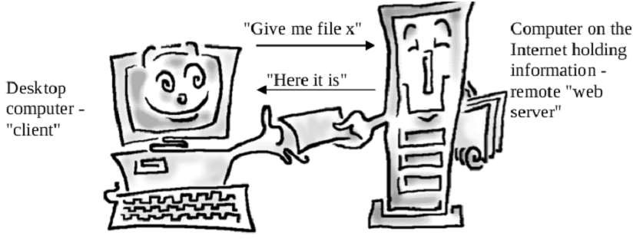
Introduction to WWW, Web Protocols and URLs
How does WWW work?
1. Client/Server Architecture
2. Request/Response Pattern

Slide 5
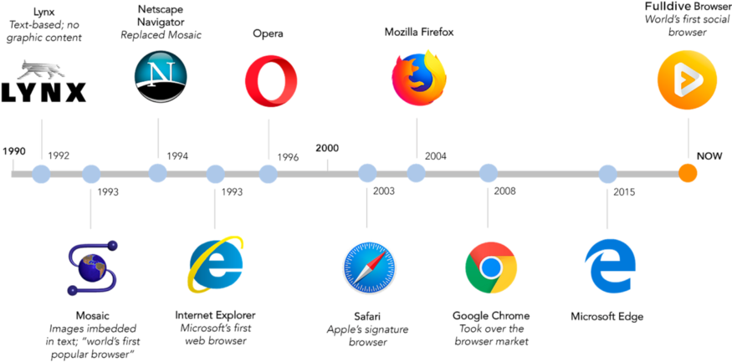

Introduction to WWW, Web Protocols and URLs
History of Web Browsers
2020
Microsoft Edge Based on chromium

Slide 6
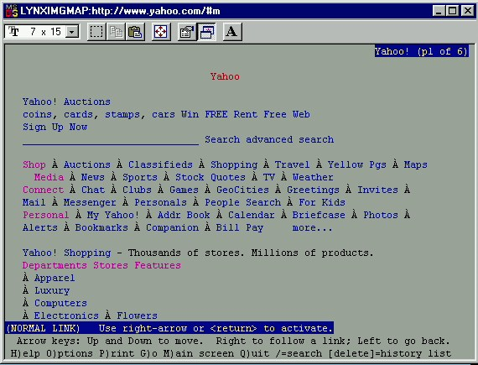
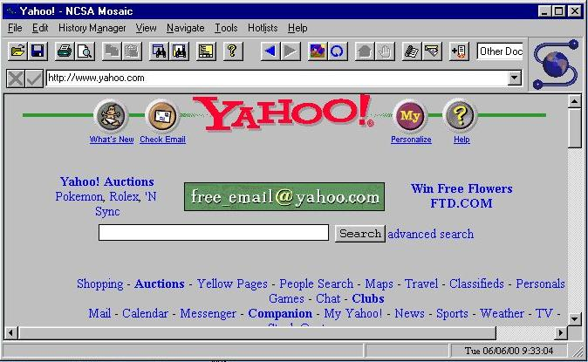
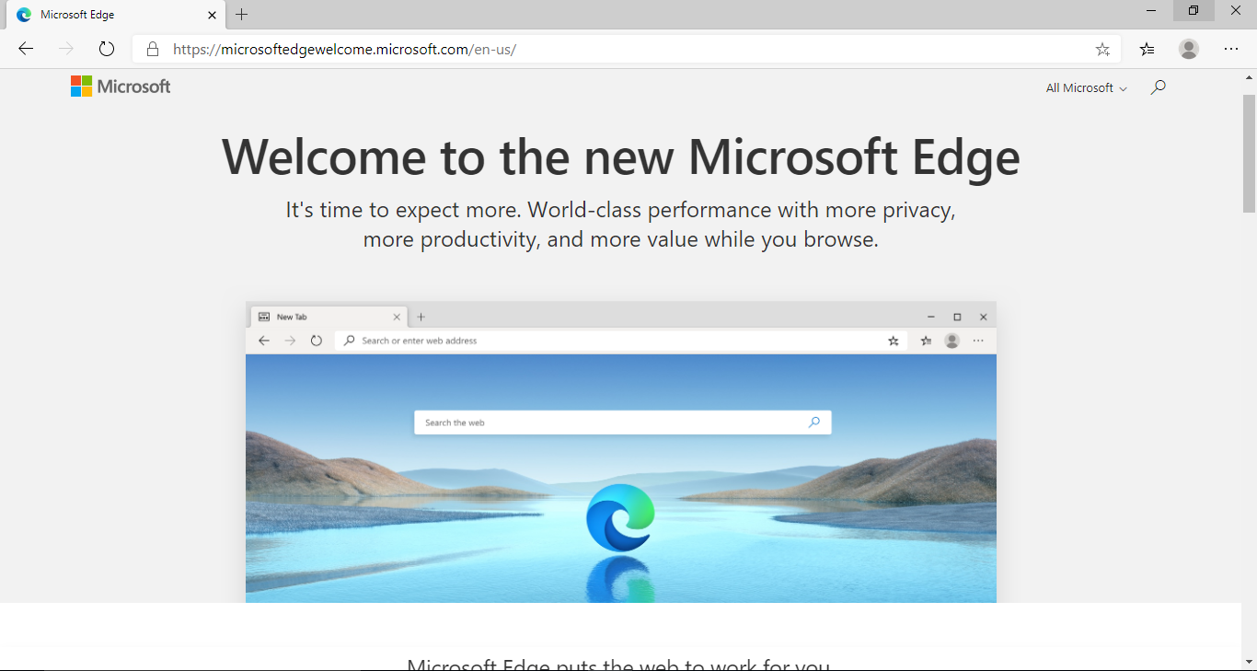
Introduction to WWW, Web Protocols and URLs
Browser Evolution
Lynx – A text based browser
Mosaic – the first graphical browser

Slide 7
Introduction to WWW, Web Protocols and URLs
URLs
URL stands for Uniform Resource Locator
General form:
scheme:object-address
For the http protocol, the object-address is:
fully qualified domain name/doc path
Example:
https://www.amazon.com/international-sales-offers.html

Slide 8
Introduction to WWW, Web Protocols and URLs
Web Servers
General Web Server Characteristics
Web servers have two main directories:
Document root (servable documents)
Server root (server system software)
Document root is accessed indirectly by clients
Its actual location is set by the server configuration file
Requests are mapped to the actual location
Popular Examples
Apache
IIS

Slide 9
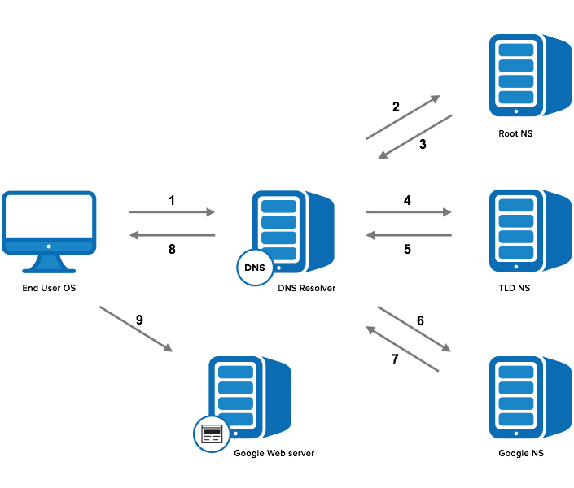
Introduction to WWW, Web Protocols and URLs
Domain Name Service
Step 1: OS Recursive Query to DNS Resolver
Step 2: DNS Resolver Iterative Query to the Root Server
Step 3: Root Server Response
Step 4: DNS Resolver Iterative Query to the TLD Server
Step 5: TLD Server Response
Step 6: DNS Resolver Iterative Query to the Google.com NS
Step 7: Google.com NS Response
Step 8: DNS Resolver Response to OS
Step 9: Browser Starts TCP Handshake

Slide 10
Introduction to WWW, Web Protocols and URLs
How to get your own website?
Steps:
1. Choose a domain name
2. Register a domain and sign up with web hosting
3. Set up a website using WordPress/Name cheap/Go Daddy (through web host)
4. Customize your website design and structure
5. Add pages and content to your website

Slide 11
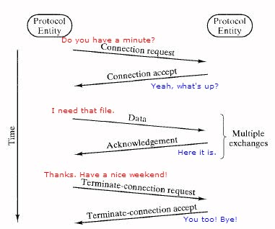
Introduction to Web Protocols and HTTP
What is a Protocol?
A protocol is a set of rules and guidelines for communicating data.
Different applications use different protocols
The web, in particular, uses multiple protocols to communicate.
The most important and visible protocols are HTTP and HTTPS.

Slide 12


Introduction to Web Protocols and HTTP
HTTP Overview
HTTP: HyperText Transfer Protocol
Application Protocol used by the Web
Client/Server model
Client: browser that requests, receives, and “displays” Web Objects
Server: Web server sends Web Objects (using HTTP protocol) in response to requests
server
running
Apache Web
server
HTTP request
PC running
Firefox browser
HTTP response
HTTP request
HTTP response
iphone running
Safari browser

Slide 13
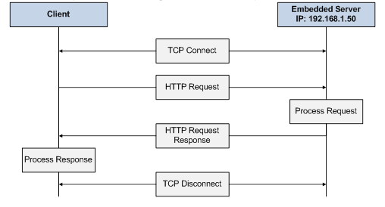
Introduction to Web Protocols and HTTP
HTTP Overview…(cntd.)
uses TCP:
client initiates TCP connection (creates socket) to server, port 80
server accepts TCP connection from client
HTTP messages (application-layer protocol messages) exchanged between browser (HTTP client) and Web server (HTTP server)
TCP connection closed
HTTP is “stateless”
server maintains no information about past client requests

Slide 14
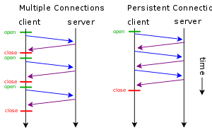
Introduction to Web Protocols and HTTP
HTTP Connections
non-persistent HTTP
at most one object sent over TCP connection
connection is then closed
downloading multiple objects required multiple connections
persistent HTTP
multiple objects can be sent over single TCP connection between client, server

Slide 15
Introduction to Web Protocols and HTTP
HTTP Requests
HTTP request is a request line, followed by zero or more request headers
Request line: <method> <uri> <version>
<version> is HTTP version of request
(HTTP/1.0 or HTTP/1.1)
<uri> is typically URL for proxies, URL suffix for servers.
<method> is either GET, POST, OPTIONS, HEAD, PUT, DELETE, or TRACE.
Request Header
Blank line (CRLF)
Message Body
GET /test.html HTTP/1.1
Accept: */*
Accept-Language: en-us
Accept-Encoding: gzip, deflate
User-Agent: Mozilla/4.0 (compatible; MSIE 4.01; Windows 98)
Host: euro.ecom.cmu.edu
Connection: Keep-Alive
CRLF (\r\n)

Slide 16
Introduction to Web Protocols and HTTP
HTTP Request Methods
HTTP methods:
GET: Retrieve static or dynamic content
POST: Send content to server through request body
OPTIONS: Get server or file attributes
HEAD: Fetches only header field without any response body
PUT: Write a file to the server
DELETE: Delete a file on the server

Slide 17
Introduction to Web Protocols and HTTP
HTTP Response
HTTP/1.1 200 OK
Date: Thu, 22 Jul 1999 04:02:15 GMT
Server: Apache/1.3.3 Ben-SSL/1.28 (Unix)
Last-Modified: Thu, 22 Jul 1999 03:33:21 GMT
ETag: "48bb2-4f-37969101"
Accept-Ranges: bytes
Content-Length: 79
Keep-Alive: timeout=15, max=100
Connection: Keep-Alive
Content-Type: text/html
CRLF
<html>
<head><title>Test page</title></head>
<body>
<h1>Test page</h1>
</html>
HTTP response is a response line followed by zero or more response headers.
Response line:
<version> <status code> <status msg>
<version> is HTTP version of the response.
<status code> is numeric status.
Response headers:
<header name>: <header data>
Provide additional information about response
Content-Type: MIME type of content in response body.
Content-Length: Length of content in response body.

Slide 18
Introduction to Web Protocols and HTTP
HTTP Response : Status Codes
Three-digit number; first digit specifies the general status
1 => Informational
2 => Success
3 => Redirection
4 => Client error
5 => Server error
<status msg> is corresponding English text.
200 OK => Request was handled without error
403 Forbidden => Client lacks permission to access file
404 Not found => Server couldn’t find the file.

Slide 19
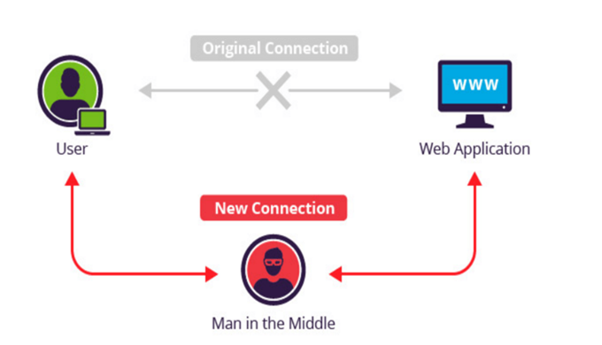
Introduction to Web Protocols and HTTP
HTTP Secure (HTTPS)
A common security attack
Need to encrypt data to save it from such attacks

Slide 20
THANK YOU
Vinay Joshi
Department of Computer Science and Engineering
vinayj@pes.edu
+91 80 2672 6622

